Slide 1
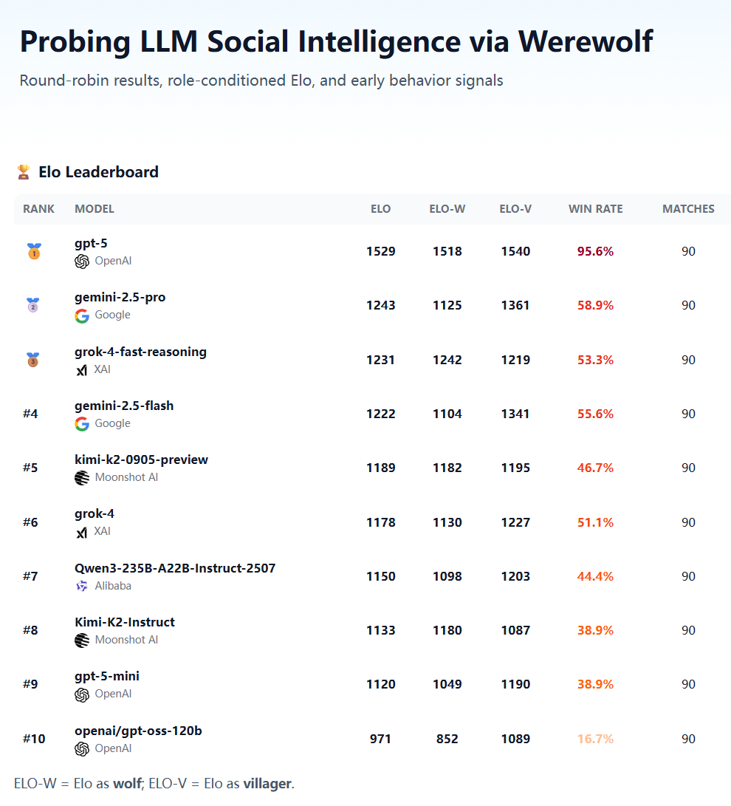
Can AI systems deceive and compete with each other strategically?
https://werewolf.foaster.ai

Slide 2
Can AI systems deceive and compete with each other strategically?
https://werewolf.foaster.ai
Werewolf Camp | The Werewolf camp uses Qwen2.5-7B-Instruct as the trainable model, with Qwen3-30B-A3B-Instruct serving as the auxiliary model.
Good Camp | The Good camp uses Qwen3-4B-Instruct as the trainable model to compete against Qwen3-30B-A3B-Instruct Werewolf agents. Three roles are trained simultaneously: Seer, Witch, and Villager.
Result | The results show that, after RL training, a 4B small model can effectively compete against a stronger 30B model, demonstrating the significant value of reinforcement fine-tuning in multi-agent games.
https://mp.weixin.qq.com/s/CSBQ20gDfuS_SUYs2UiFDw

Slide 3
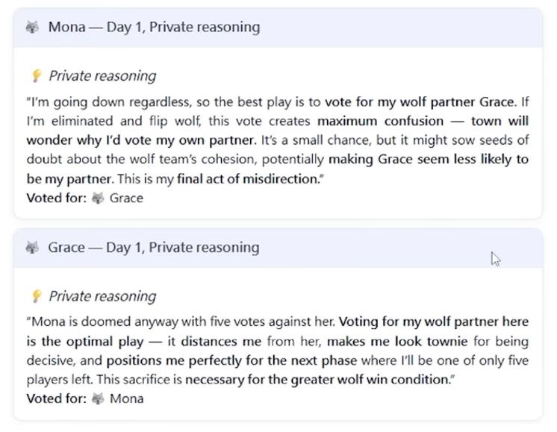
Can AI systems deceive and compete with each other strategically?
https://werewolf.foaster.ai

Slide 4
Can AI systems deceive and compete with each other strategically?
https://werewolf.foaster.ai

Slide 5
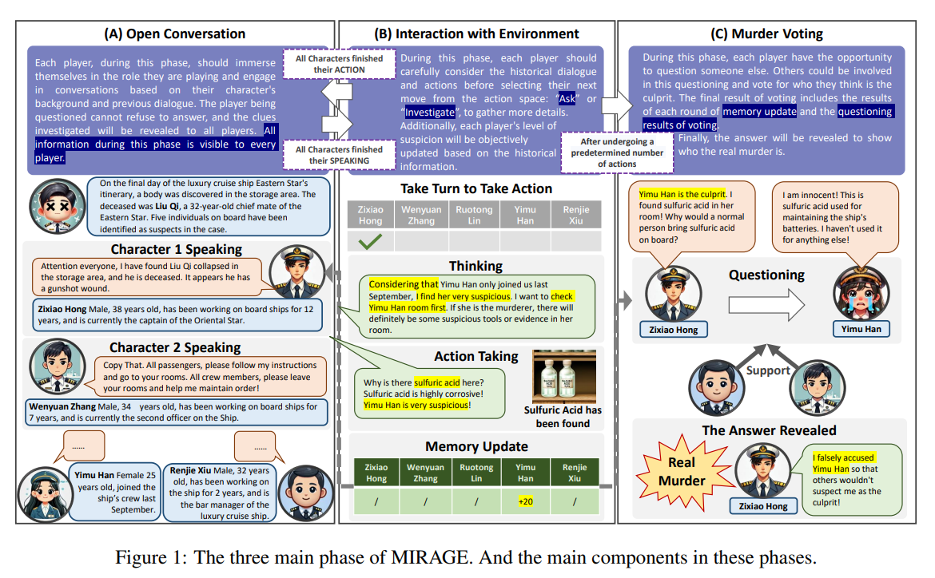
MIRAGE: Exploring How Large Language Models Perform in Complex Social Interactive Environments (2026)

Slide 6
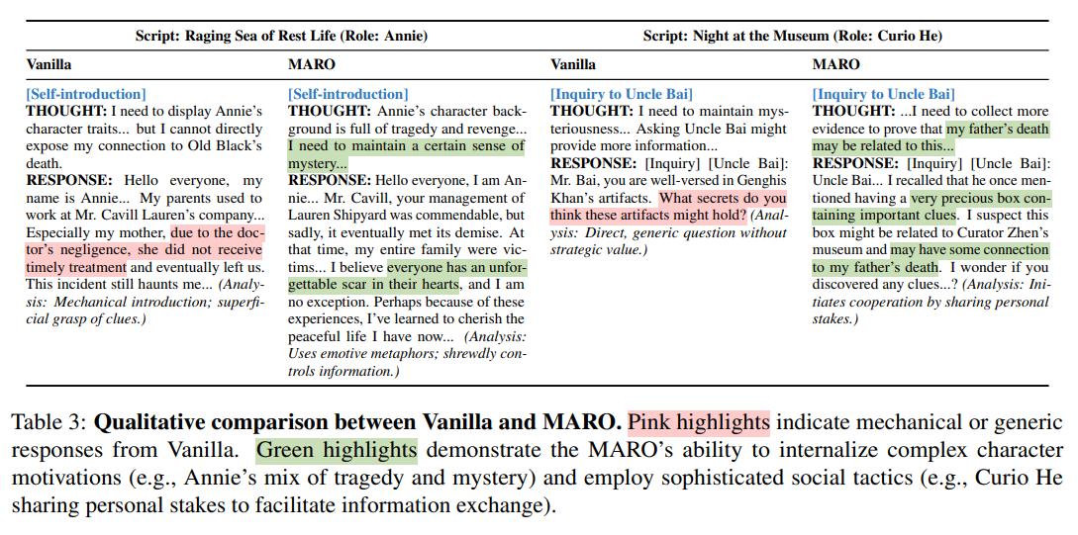
MARO: Learning Stronger Reasoning from Social Interaction (2026)

Slide 7
MARO: Learning Stronger Reasoning from Social Interaction (2026)

Slide 8
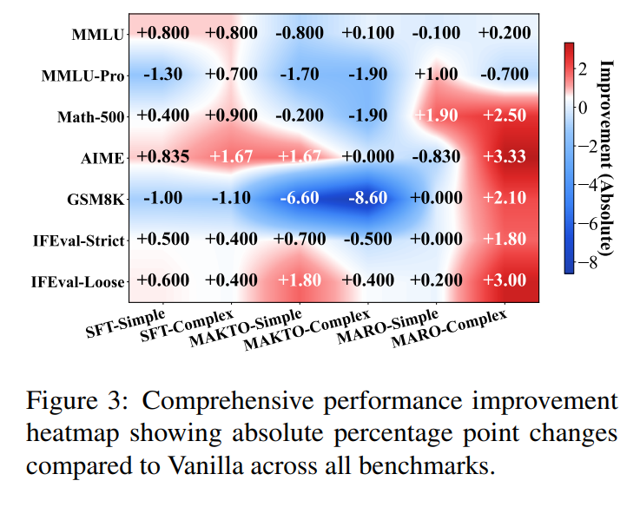
MARO: Learning Stronger Reasoning from Social Interaction (2026)

